Slide 1
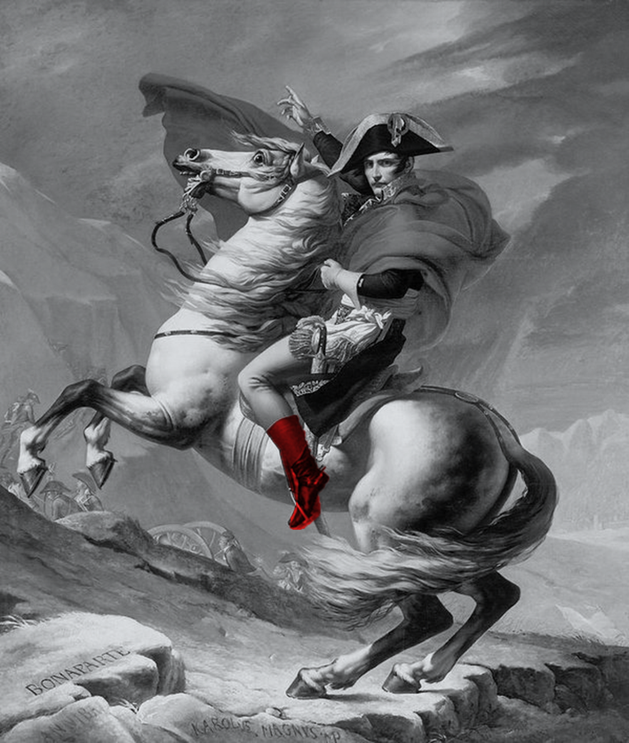
Predicting Russian
Tank Army doctrine from historical patterns of doctrine development
Dr Darrell Jaya-Ratnam (DIEM Analytics)
Lt Col R Siewert (NATO SHAPE Red Team)
ISMOR 42
July 2025

Slide 2
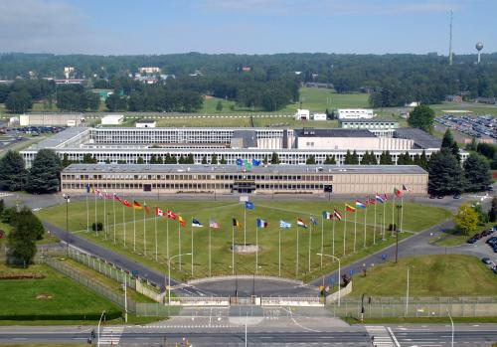
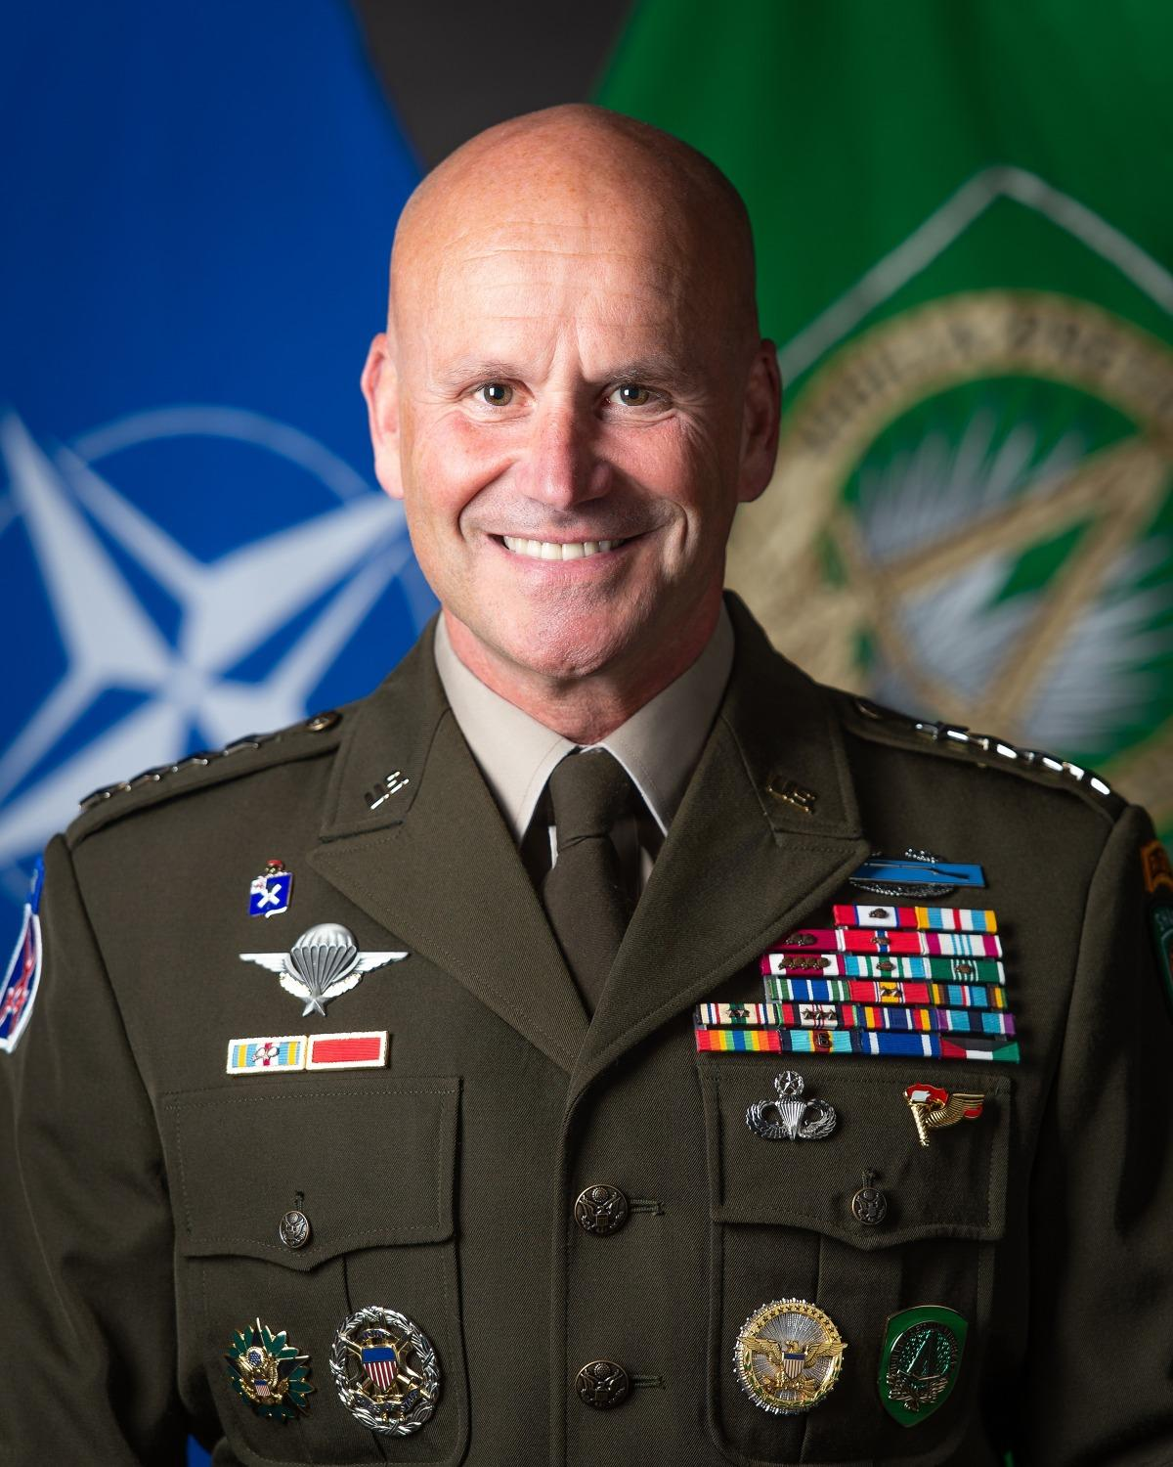
Supreme Headquarters
Allied Powers Europe (SHAPE)
“We had previously been optimized for a very different task”
“We have completely reorganized my headquarters at SHAPE”
“It is now organized in a warfighting fashion”
General Christopher Cavoli, SACEUR
ACO, with its headquarters at SHAPE near Mons, Belgium is responsible for the planning and execution of all NATO military operations and is headed by SACEUR. It has the ability to operate at three overlapping levels: strategic, operational and tactical. SHAPE is a strategic headquarters. Its role is to prepare, plan, conduct and execute NATO military operations, missions and tasks in order to achieve the strategic objectives of the Alliance.
Notes:
As SHAPE undergoes a reform to a warfighting HQ, the Red Team has been established to guarantee a strategical, independent, cross functional multi dimensional predictive analysis supporting the Decision making Process of SACEUR.

Slide 3
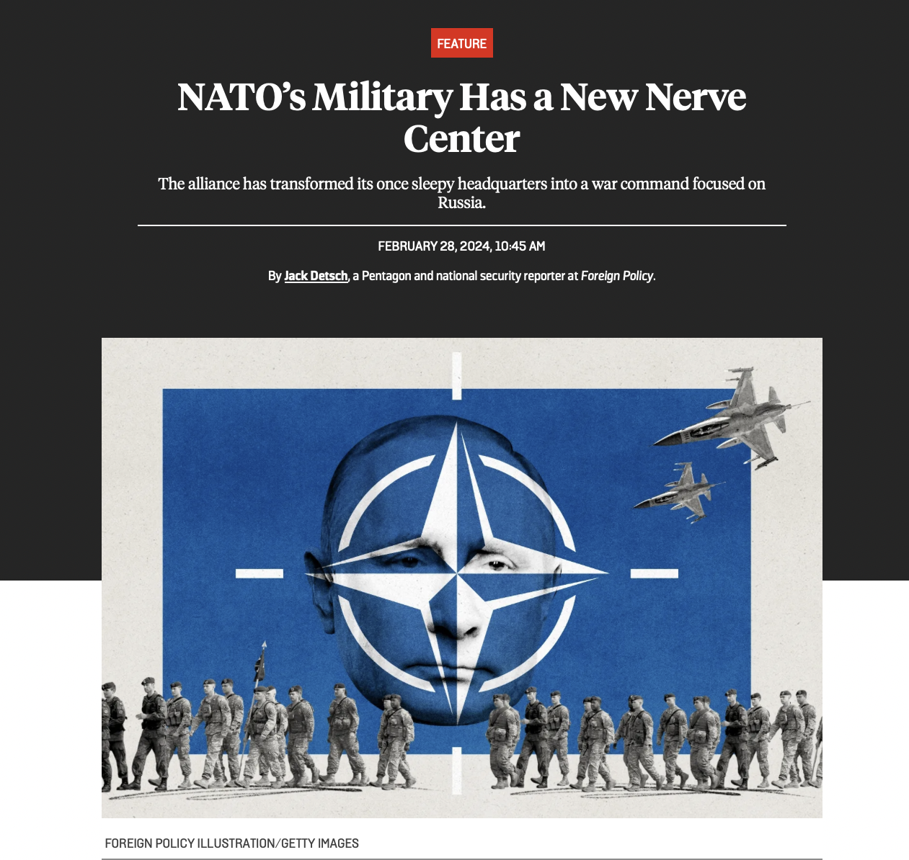
“SHAPE’s experts are still looking at how to optimize intelligence gathering, integrating artificial intelligence into the headquarters, and building out their own wargaming capability, with a team of experts who live, breathe, eat, and sleep Russian tactics as the “red team” on the other side.” (Foreign Policy - https://foreignpolicy.com/2024/02/28/nato-russia-ukraine-war-shape-command-center-headquarters-military-reforms/)
Notes:
The basic tasks of a classical Red Team are continuously conducted by SHAPE Red Team in order to ensure the highest possible quality of HQ products. However the main effort of SHAPE Red Team is the function as an independent Think tank identifying and answering the essential Intel tasks of SACEUR within the next 16 to 24 month.

Slide 4
Introduction | Research questions and hypotheses
Who’s experience from WW2 drove the post-1945 doctrine?
The author of the doctrine?
Assuming we know what they knew/ thought at the time doctrine was written
The most successful commanders?
The most teachable practices?
The most successful operations?
What will Russian tank army doctrine be in 2030+ as a result of experience from Ukraine?
What aspect of their experience drove the doctrine?
Distances advanced?
Endurance or time taken?
Own losses (absolute or %)?
Enemy losses (absolute or %)?
What experiences have tank army commanders in Ukraine gained?
Who were the tank army commanders in Ukraine?
Assuming conversion from success to doctrine after WW2 will be the same after Ukraine
Distances advanced?
Endurance or time taken?
Own losses (absolute or %)?
What were their experiences?
Enemy losses (absolute or %)?

Slide 5
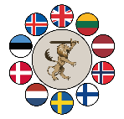
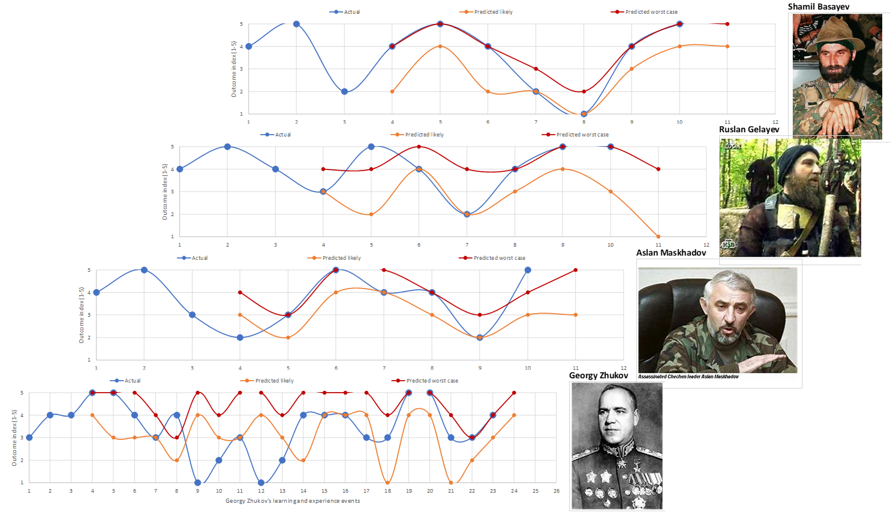
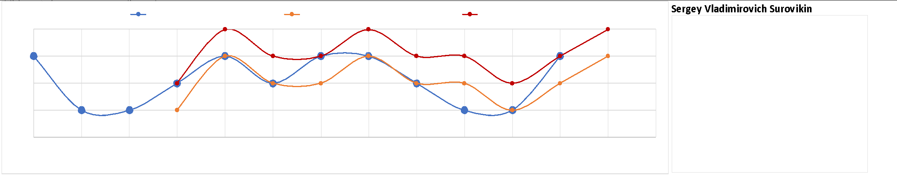
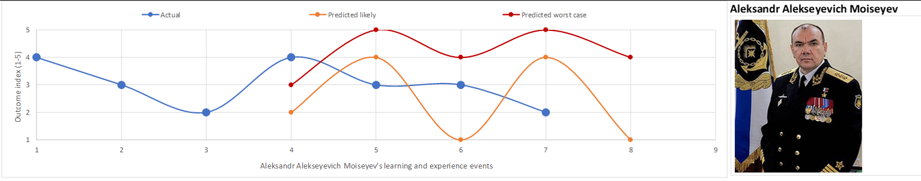
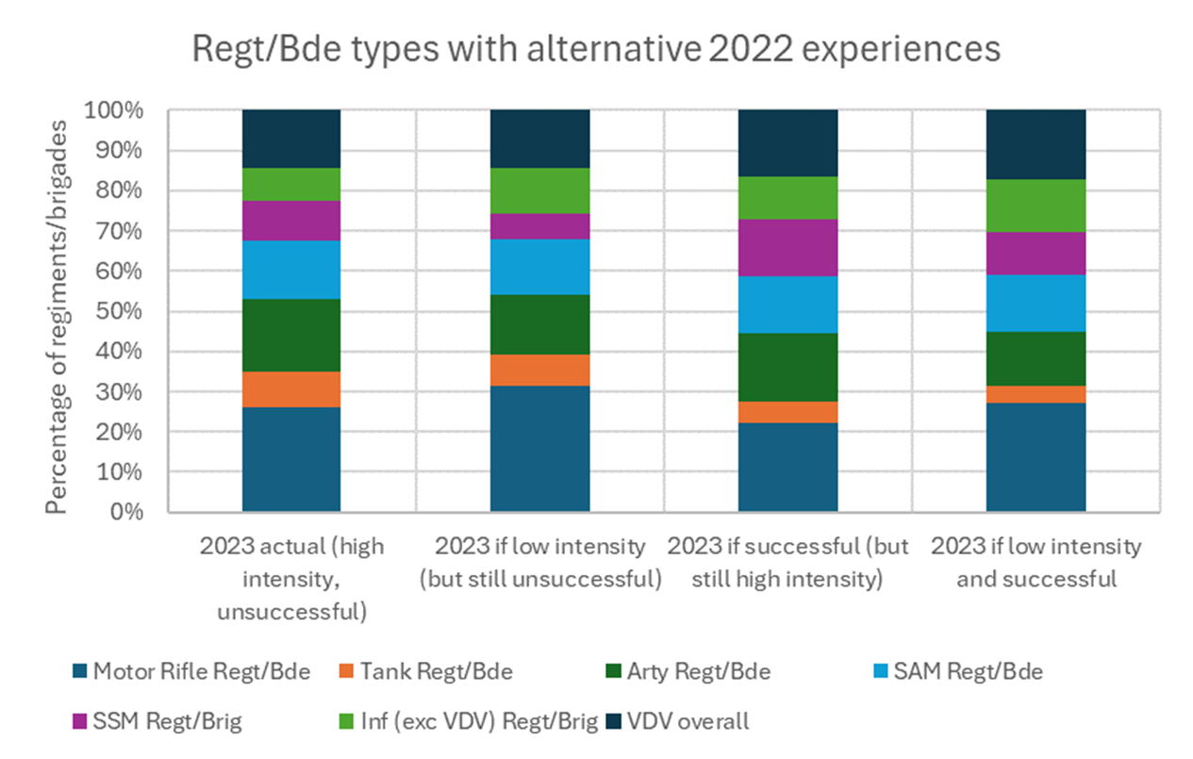
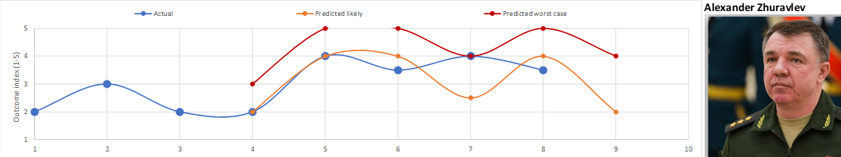
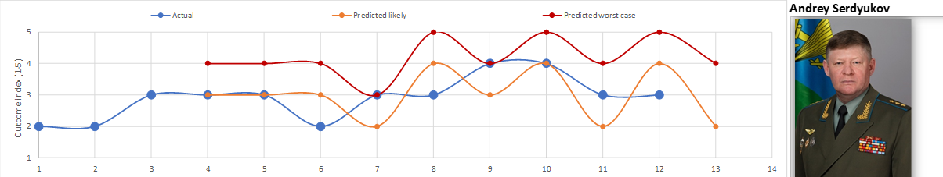
Introduction | Use of the Red’s Shoes AI
Proof-of-concept (2019)
  4 historic commanders
  2 contemporary commanders (as of 2019)
Pilot (2022)
  Applied to Surovikin and Moiseyev
Development (2023/24)
  Predicting Force structures from learning cycles

Slide 6
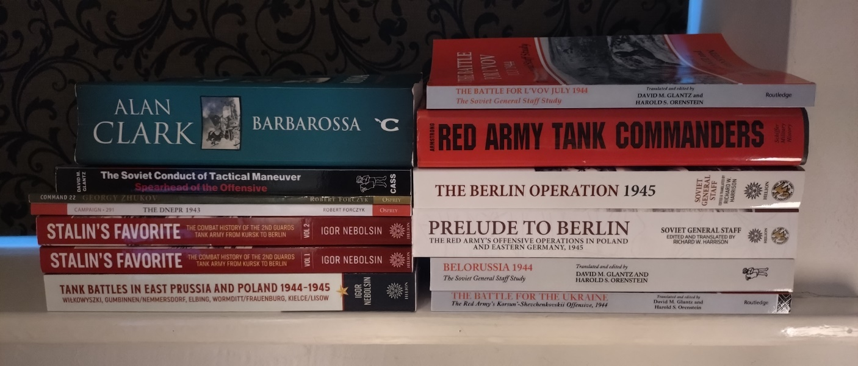
Introduction | Input data
Cycle 1
Long list of articles and papers on Russian ‘ways of warfare’
Initial trawl using LLM of WW2, post-war and Ukraine commanders, doctrine and performance
Cycle 2
Contemporary analysis and
accounts of WW2 tank army
operations and commanders
Compared to LLM outputs
Input contemporary data
Refined prompts for Ukraine data

Slide 7
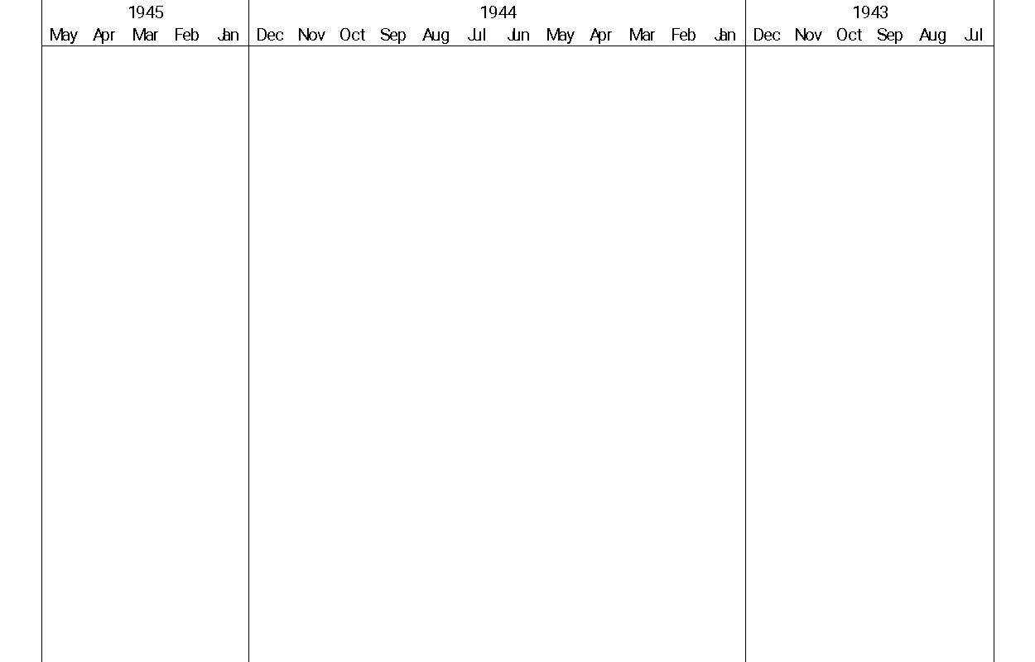






WW2 tank army and commander analysis | Operations analysed
Berlin
East Pomerania
Vistula-Oder
Rotsmistrov
replaced
3GTA
Silesia
Rybalko
Bagration
Kravchenko appointed
6GTA
Rotsmistrov
5GTA
Doctrine Conference
Dniepr
1GTA
Prague
Korsun-Shevchenkovsk
Kursk (inc Orel)
Katukov
Lvov-Sandomierce
Belgorod-Kharkov
Vienna
(incl Balaton)
Budapest
Dniepr-Carpathian
Bogdanov appointed
2GTA
Belgrade
(incl Debrecen)
4GTA
Lelyushenko appointed
Iassy-Kishinev

Slide 8
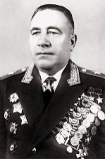
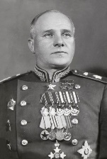
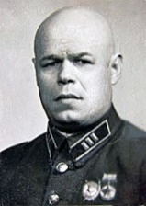
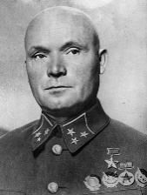
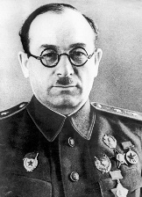
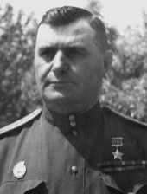
WW2 tank army and commander analysis | Commanders’ profiles
Name
GTA
Education
1st armour command
During purge
1st tank army command
Influence on doctrine during war
Katukov
1st GTA
Stalin Academy (armd/mech)
1938, 5th Lt Tk Bde, 34MC
No impact
January 1943, 1TA
At conferences on doctrine
Bogdanov
2nd GTA
Vystrel, Cmdt Stalin academy
1934, 134th Mech Bde
Imprisoned
September 1943, 2TA
?
Commanded Katukov (in 134th Mech)
Rybalko
3rd GTA
Frunze, Kazan Armd Sch Instr
1942, 5th TA
Benefited
September 1942, 3TA
At conferences on doctrine
Lelyushenko
4th GTA
Frunze
1939, 39th Lt Tk Bde
No impact
March 1944, 4TA
At conferences, commanded Katukov and Rotmistrov
Rotmistrov
5th GTA
Frunze, Stalin Academy, PhD
1941, 3rd Mech Corps
No impact
February 1943, 5GTA to Aug’44
As DC Armd & Mech forces, led doctrine conferences
Kravchenko
6th GTA
Frunze, Saratov Armd Sch Inst
1941, 31st Tk Bde
No impact
January 1944, 6TA
?

Slide 9
WW2 tank army and commander analysis | Commanders’ styles
Name
GTA
Prep focus
Planning
Orders
Coordination
Approach
Decision focus
Tactical focus
Katukov
1st GTA
Driver training
War council
Prodded
Personally
Conservative risk taker
Preempt?
Forward dets, and raids
Bogdanov
2nd GTA
Subordinates
Rely on COS
Directed
Rely on COS
Impulsive, tenacious
Commit now?
Air and arty support
Rybalko
3rd GTA
Vehicle driving
Sub-comdrs
Directed
Sandbox Ex
Impulsive, tenacious
How to adapt?
Assist rifle units in penetration
Lelyushenko
4th GTA
Tank gunnery
Independent
Socratic
Personally
Conservative risk taker
How to adapt?
Support to subordinates
Rotmistrov
5th GTA
Driver training
Sub-comdrs
Participatory
Eyes-on
Future focussed
Attack signal?
Army structure & coordination
Kravchenko
6th GTA
Driver training
Independent
Led by example
Eyes-on
Conservative risk taker
Attack signal?
Assist rifle units in penetration

Slide 10
WW2 tank army and commander analysis | Doctrinal similarity
Doctrine Element | 1945–1953 Doctrine | Post-1953 Doctrine
Command Philosophy | Centralized, rigid hierarchical control. Commanders expected to strictly follow orders from higher echelons. | Centralized but more flexible with emphasis on preemptive initiatives at operational levels.
Operational Objectives | Prioritized large-scale encirclements to destroy enemy forces and gain strategic depth. | Focused on containment and limited offensives to protect strategic assets.
Offensive Operations (Manoeuvre Tactics/TTPs) | Massed tank formations with limited manoeuvre flexibility; linear offensives. | Combined arms with increased reliance on maneuverability and technological advancements.
Coordination with Other Forces | Coordination focused on strict adherence to combined arms principles. | Independent operations for tank armies, with less dependence on infantry coordination.
Sustainment and Supply Lines | Highly centralized logistics dependent on pre-positioned depots. | Decentralized logistics supporting mobile, fast-moving units.
Force Preservation | Losses acceptable for achieving breakthrough objectives. | Emphasis on reducing casualties by leveraging precision strikes and technology.
Technology and Weaponry | Mass deployment of T-34 variants; artillery dominant. | Gradual shift to advanced tanks (e.g., T-54) and increased focus on airpower support.
Adaptability | Limited adaptability; strict adherence to predefined plans. | High adaptability to new technologies and battlefield conditions.
Strategic Objective | Achieve strategic depth by creating buffer zones against NATO threats. | Maintain strategic parity with NATO while focusing on mobility and deterrence.
Defensive Operations (Positional tactics/TTPs) | Layered defensive systems using tank armies as mobile reserves. | Emphasis on mobile defense rather than static positions.
Logistics in Contested Zones | Focused on rail logistics; high reliance on captured infrastructure. | Independent logistics capable of adapting to contested conditions.
Morale and Resilience | Emphasis on ideological indoctrination to maintain high morale. | Increased focus on professionalization and technological edge to sustain morale.
Weather and Terrain | Weather less relevant due to centralized, pre-planned operations. | Greater emphasis on terrain exploitation to outmanoeuvre NATO forces.
Reserve Mobilization | Centralized reserve pools allocated based on strategic needs. | Mobile reserve forces with rapid deployment capability.

Slide 11
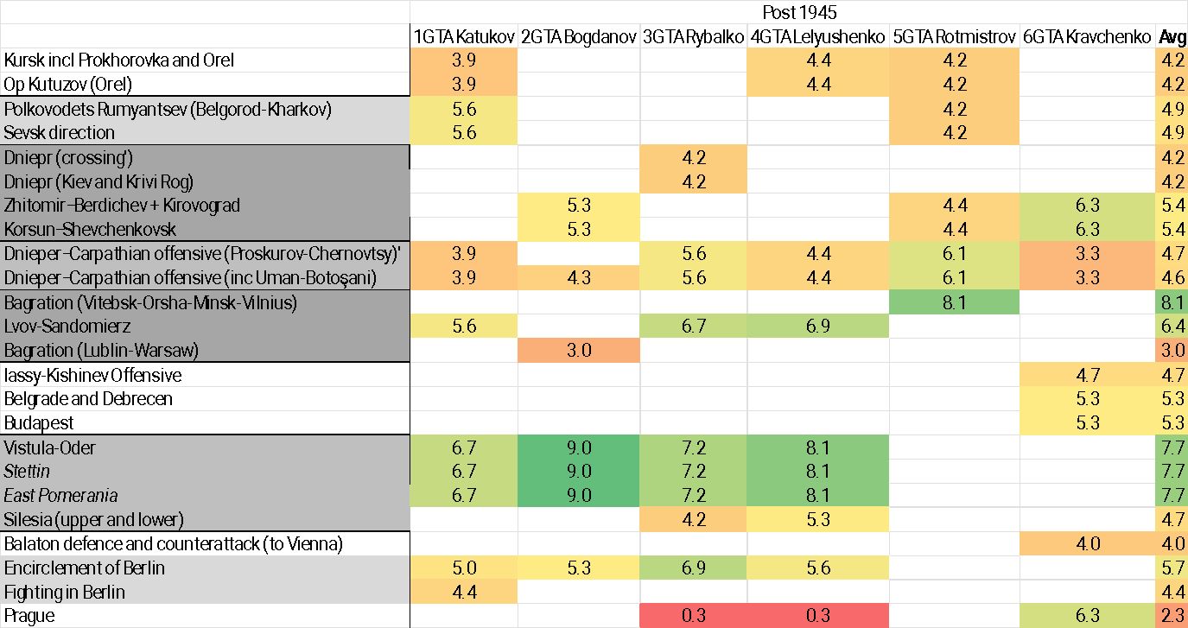
WW2 tank army and commander analysis | Doctrinal similarity
Rotmistrov showed the greatest similarity to the post-1945 doctrine in Bagration but was fired soon after
After Rotmistrov’s doctrine conference, three commanders displayed doctrine very similar to post-1945

Slide 12
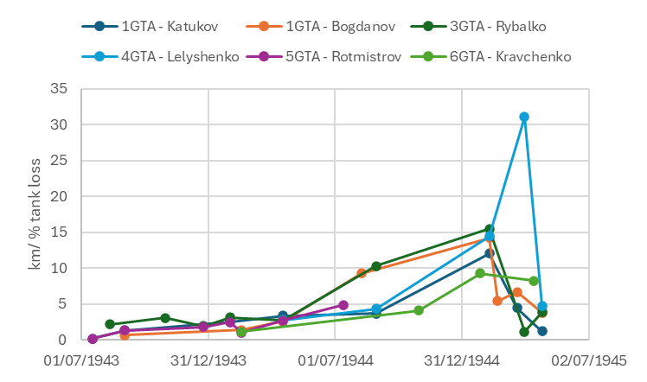
WW2 tank army and commander analysis | Doctrine learning-drivers
Km per % tanks lost: Most significant learning driver across all 6 tank army commanders
Takes a year before certain commanders (Bogdanov and Rybalko) see significant increase from their experience and learning (in the Bagration and Lvov-Sandomierz offensives, respectively). Rotmistrov performed poorly in comparison
Doctrine conferences and staff rides, run by Rotmistrov (moved on after Bagration), share learning
Takes another 6 months (18 months in all), for all commanders to see improvement (in the Vistula-Oder offensive)
Note: Graph includes the encirclement of Berlin, but excludes the fighting in Berlin and the Prague offensive

Slide 13
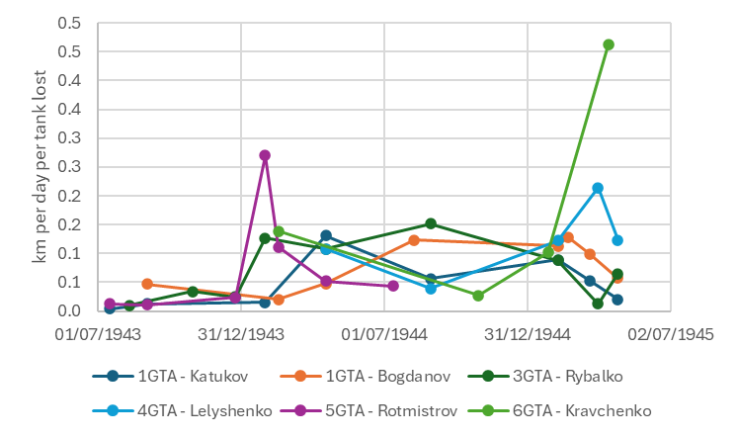
WW2 tank army and commander analysis | Doctrine learning-drivers
Km per day per tank lost: Second most significant learning driver across all 6 tank army commanders
After 6 months Rotmistrov peaks but then falls behind other tank army commanders
Then Bogdanov and Rybalko peak but remain as high-performing as the other commanders
Note: Graph includes the encirclement of Berlin, but excludes the fighting in Berlin and the Prague offensive

Slide 14
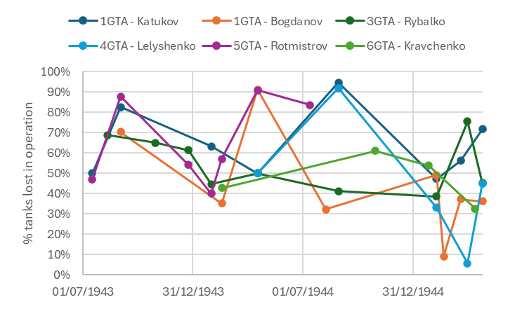
WW2 tank army and commander analysis | Doctrine learning-drivers
% tanks lost: Third most significant learning driver across all 6 tank army commanders
Significant operation to operation variation amongst individual commanders e.g. Katukov and Rotmistrov
Rybalko, the commander with the highest learning effect across the most learning drivers had the least volatile % tanks lost across operations (gentle decrease until Mar’45 (Silesia)
Although there are peaks for certain operations, there is a clear trend downwards in the minimum, i.e. best-achieved, % tanks lost
Rotmistrov replaced as commander of 5GTA after this point, due to high % tank losses and low km per % tank loss (shown on previous slide)
Note: Graph includes the encirclement of Berlin, but excludes the fighting in Berlin and the Prague offensive

Slide 15
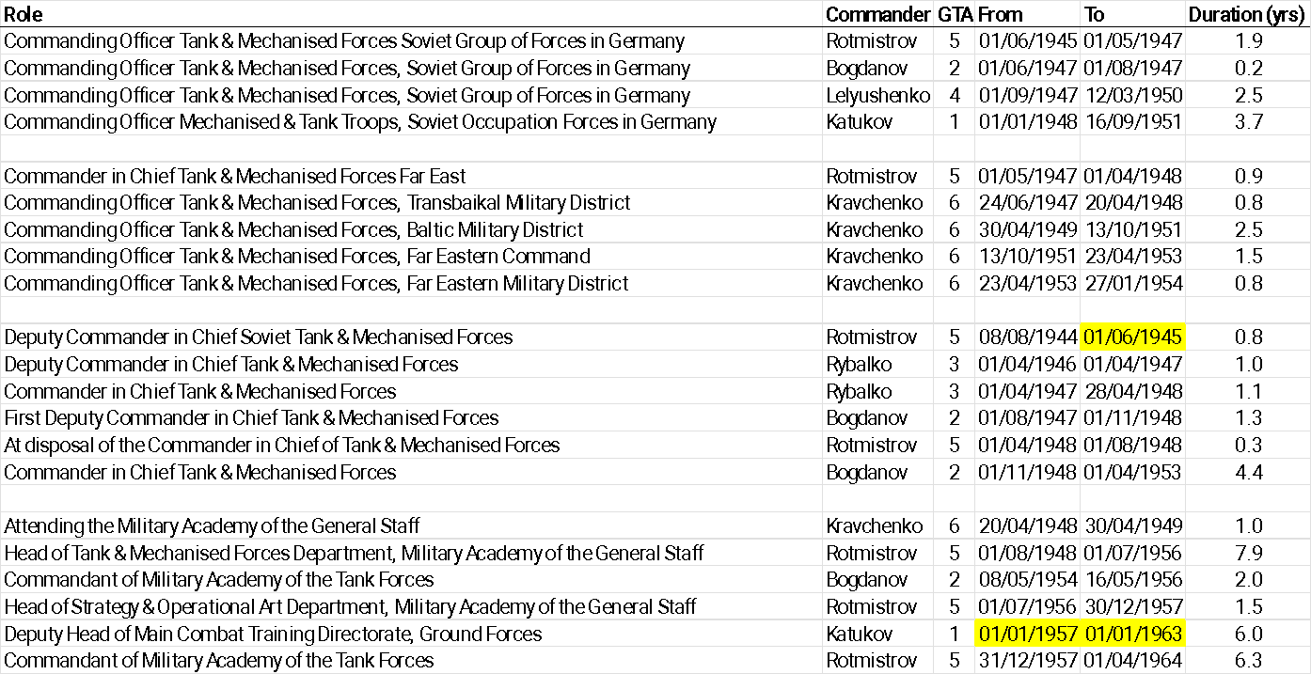
WW2 tank army and commander analysis | Post-war influence
Bogdanov and Rybalko held the same posts with input to doctrine as Katukov and Rotmistrov
Katukov and Rotmistrov held these posts for longer, which may explain why they are credited with post-war doctrine
However, Katukov, Bogdanov and Rybalko all exemplified the post-1945 doctrine in the Vistula-Oder offensive

Slide 16
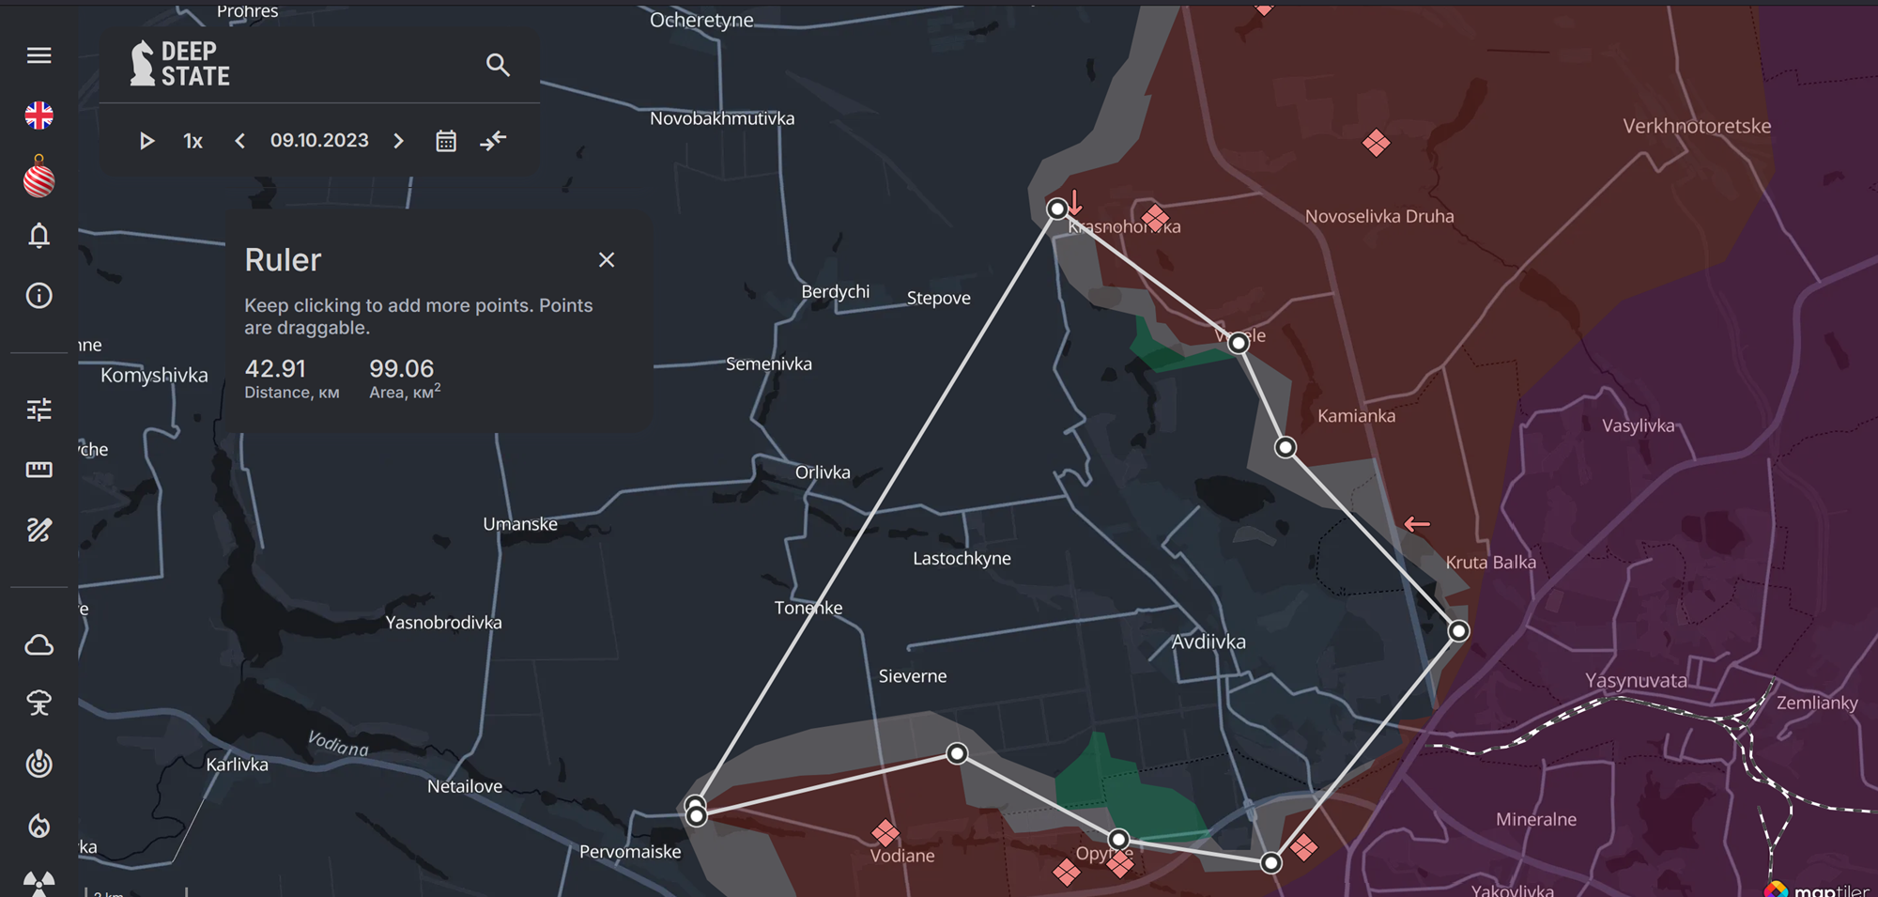
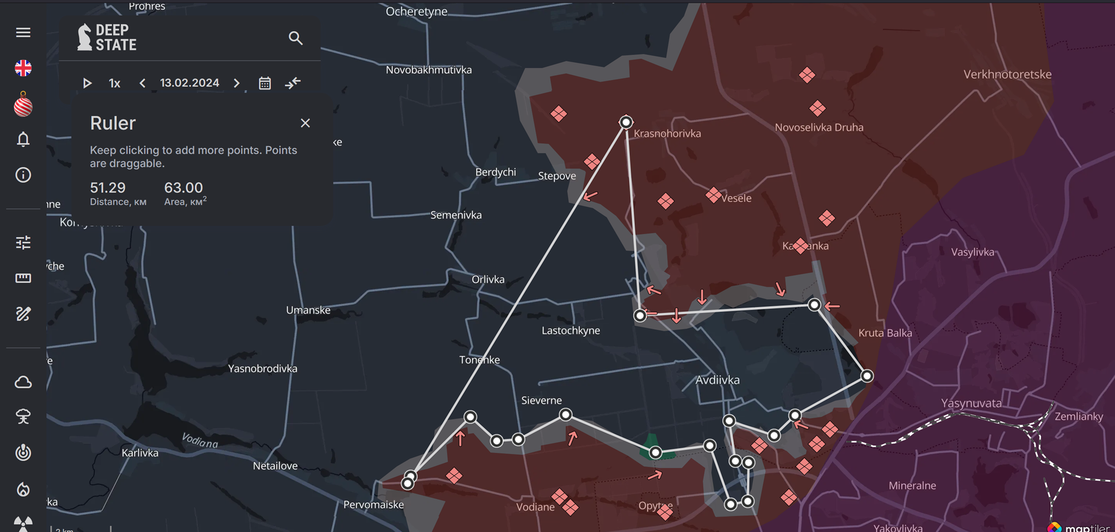
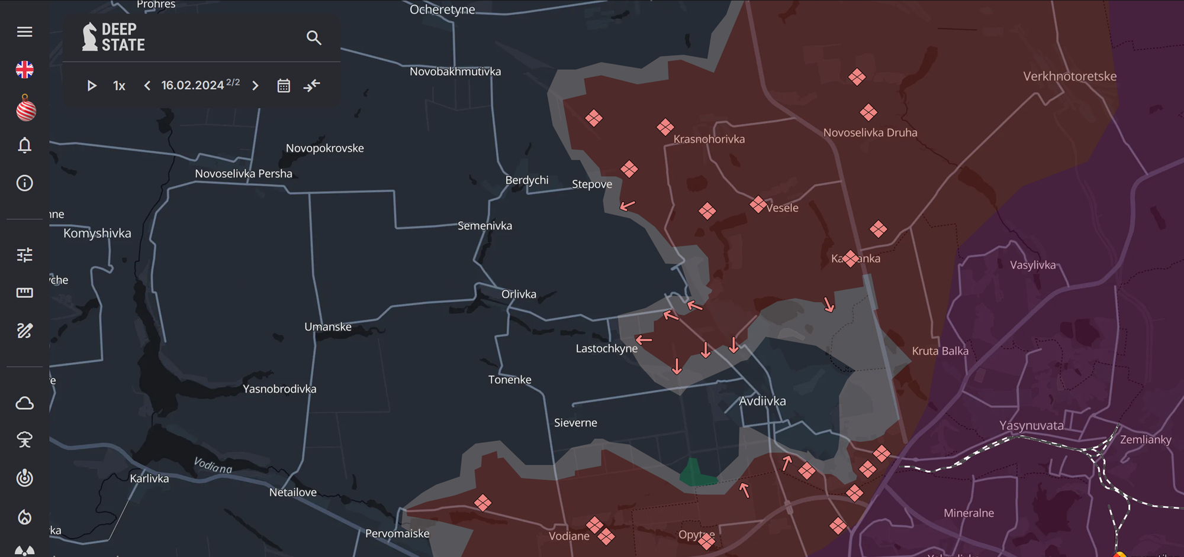
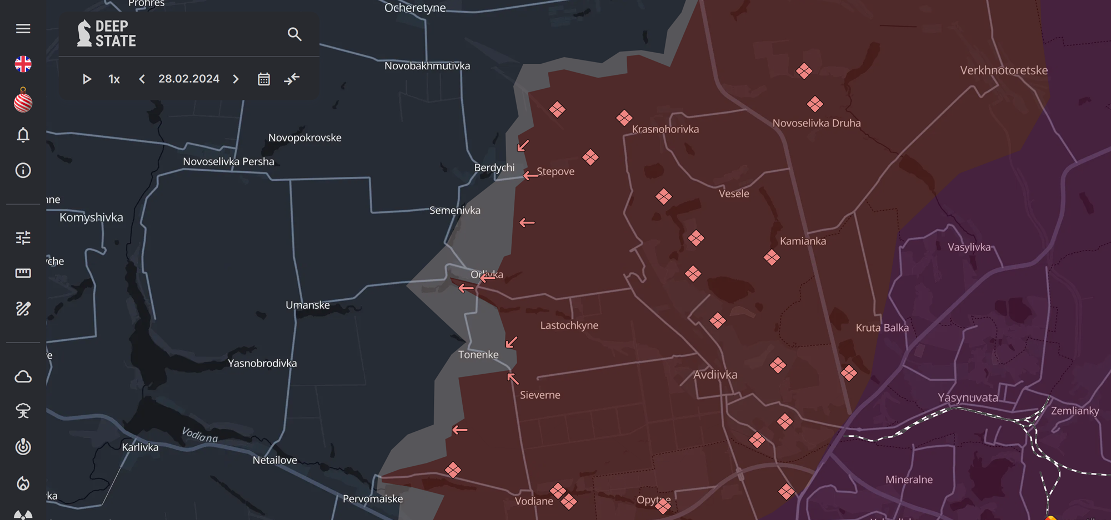
Ukraine tank army analysis | Avdiivka Oct’23-Feb’24
Some evidence on 1GTA involvement in Avdiivka
The Avdiivka ‘salient’ northern shoulder formed Apr-Aug’22, southern shoulder formed Aug’22 to Feb’23
Salient on 9 Oct’23 (op start) was 99km², by 13 Feb’24 (127 days, of which 101 had fighting) was 63km²
Salient collapses 17-28 Feb’24. First 101 days 0.36km²/day, final 15 days 4.2km²/day, overall 0.85km²/day

Slide 17
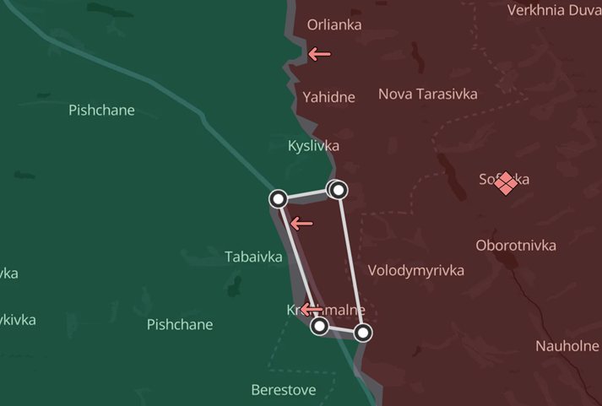
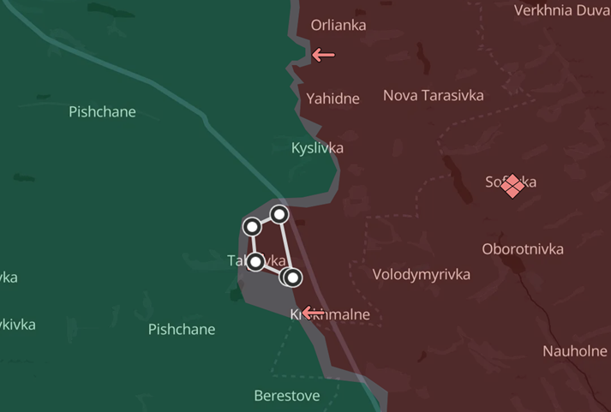
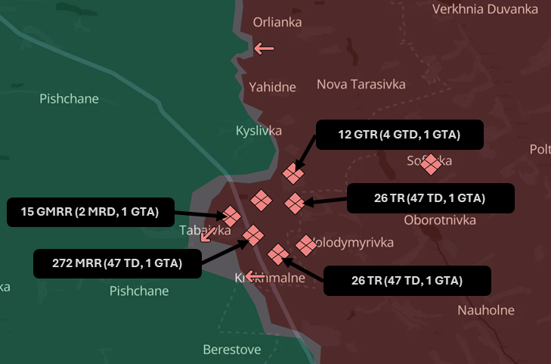
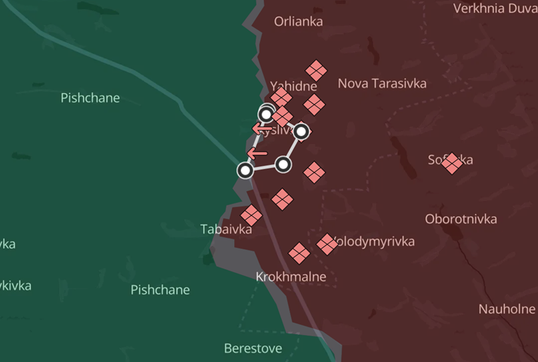
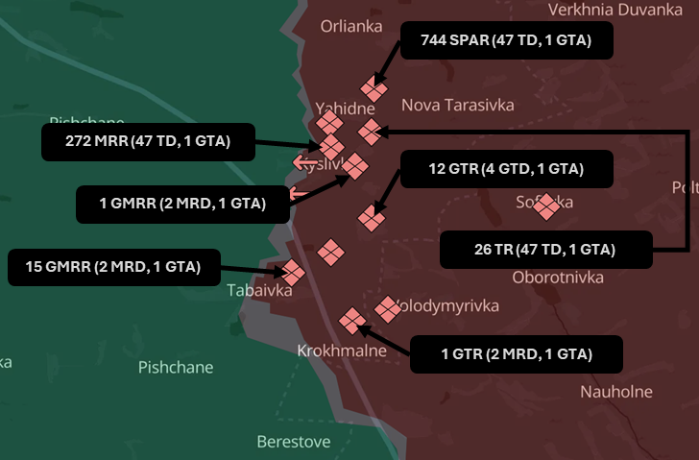
Ukraine tank army analysis | Luhansk-Kharkiv border Jan-May’24
Substantial evidence of 1GTA involvement in Luhansk-Kharkiv border in 2024 (towards Kupyansk)
Analysis of sqkm captured over time illustrates trends of short ‘seize-and-hold’ operations by 1GTA
  14km² 19-20 Jan (7km²/day), 3km² 26-28 Jan (1km²/day), by 2xMRR+3xTR from all 3Divs of 1GTA
This formed a small salient
This 4.5km² was captured between 25Apr and 4May’24
Note in both actions
  Units from all Divs mixed
  MRRs forward
  TRs at rear or on flanks

Slide 18
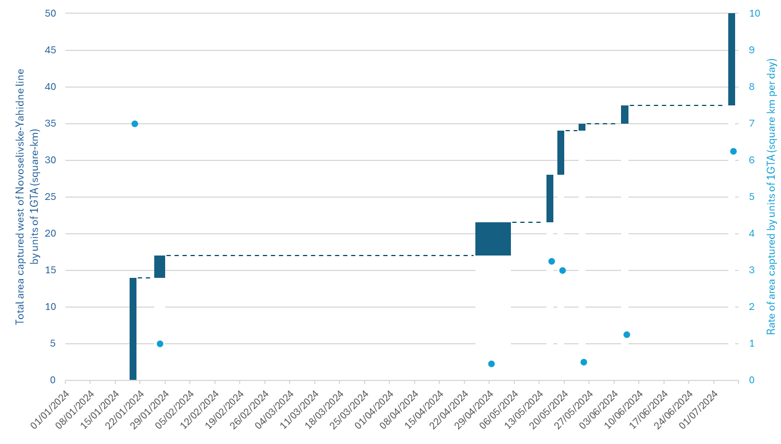
Ukraine tank army analysis | 1GTA under Podlesny
Podlesny shows a similar learning-cycle due to km²/day captured that Rotmistrov and Bogdanov showed due to km/day advanced

Slide 19
Comparison of WW2 and Ukraine | Potential doctrinal learning
Lessons learned by GTAs from the Bagration and Lvov-Sandomierz operations
Advanced 25 km from jump-off to point of operation (cf 200 km move of 3GTA prior to Kiev, Nov’43)
High offensive tempo (up to 20-25 km/day)
Normally 15 km penetration front, in this case 5 km
Tanks committed after combined arms penetrate
Insufficient assistance of neighbours
Hastily prepared attacks on defences fail
Recce not employed to reveal enemy firing positions
Similarity or difference in apparent lessons learned in Avdiivka and Luhansk-Kharkiv by units of 1GTA
Mobility of armour used behind the lines to switch point of operation of units
Short actions focussed on areas
  Capture ~10 km² in 2-3 days (ideally)
  1-5 days reorganisation
  Attempt additional advance
  If less than 5 km² captured switch focus
MRRs lead assaults, TRs kept to rear on flanks
Units from multiple Divs mixed in assaults
If salient formed, reduce after prep (~0.5 km²/day)
ISTAR means cannot concentrate forces forward
ISTAR means cannot advance into enemy depth

Slide 20
Conclusions | Research questions and hypotheses
Who’s experience from WW2 drove the post-1945 doctrine?
The author of the doctrine?
Assuming we know what they knew/ thought at the time doctrine was written
The most successful commanders?
The most teachable practices?
The most successful operations?
What will Russian tank army doctrine be in 2030+ as a result of experience from Ukraine?
What aspect of their experience drove the doctrine?
Distances advanced?
Endurance or time taken?
Own losses (absolute or %)?
Enemy losses (absolute or %)?
What experiences have tank army commanders in Ukraine gained?
Who were the tank army commanders in Ukraine?
Assuming conversion from success to doctrine after WW2 will be the same after Ukraine
Distances advanced?
Endurance or time taken?
Own losses (absolute or %)?
What were their experiences?
Enemy losses (absolute or %)?

Slide 21
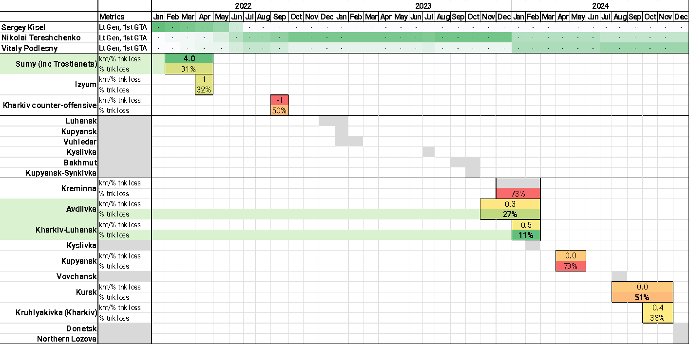
Conclusions | Research answers
Who’s experience from WW2 drove the post-1945 doctrine?
Authors of the doctrine? Partly
Rotmistrov and Katukov held relevant positions for longest but were not best
Assuming we know what they knew/ thought at the time doctrine was written
Most successful cmdr(s)? Yes
Bogdanov and Rybalko did better re drivers but held positions for less time
Most teachable practices? Partly
Perhaps Katukov’s practices were more easily taught and implemented?
Most successful operations? Yes
Vistula-Oder was the exemplar from…
Lvov-Sandomierz & Bagration lessons
Russian tank army doctrine 2030+?: ~Sumy early’22 or Avdiivka/ Kharkiv-Luhansk early’24
Distances advanced? Yes
Dominant learning drivers of doctrine were
km of advance per % tank losses (~depth of penetration ‘benefit’)
% tank losses (~cost)
km of advance per day of operation per % tank losses (~speed, depth vs cost)
What aspect of their experience drove the doctrine?
Endurance or time taken? Yes
Own losses? Yes, %
Enemy losses? No
Difficult to link to individual army action
Dependent on enemy reaction
What experiences have tank army commanders in Ukraine gained?
Who were the tank army commanders in Ukraine?
Assuming conversion from success to doctrine after WW2 will be the same after Ukraine
What were their experiences?

Slide 22
Predicting Russian
Tank Army doctrine from historical patterns of doctrine development
Dr Darrell Jaya-Ratnam (DIEM Analytics)
Lt Col R Siewert (NATO SHAPE Red Team)
ISMOR 42
July 2025

